Slide 1
Healthcare Record Keeping Database System
By: Nathan Lucero

Slide 2

Motivation
Healthcare organizations are great examples of database systems that mange large amounts of data.
Solving a Healthcare system’s logistics problem concerning time and physical space
Solution is to develop an application that can:
1. Help an organization with storage allocation.
2. Help speed up the time consuming process of logging in enormous amounts of sensitive record documentation.

Slide 3
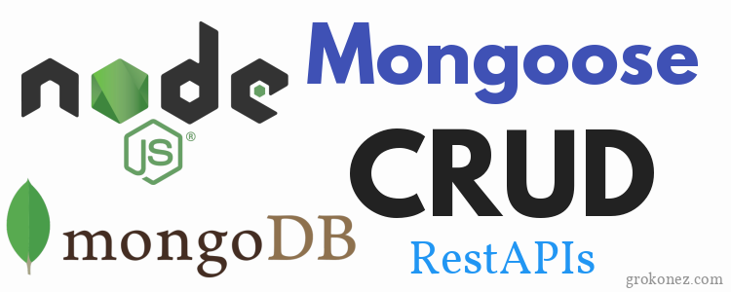
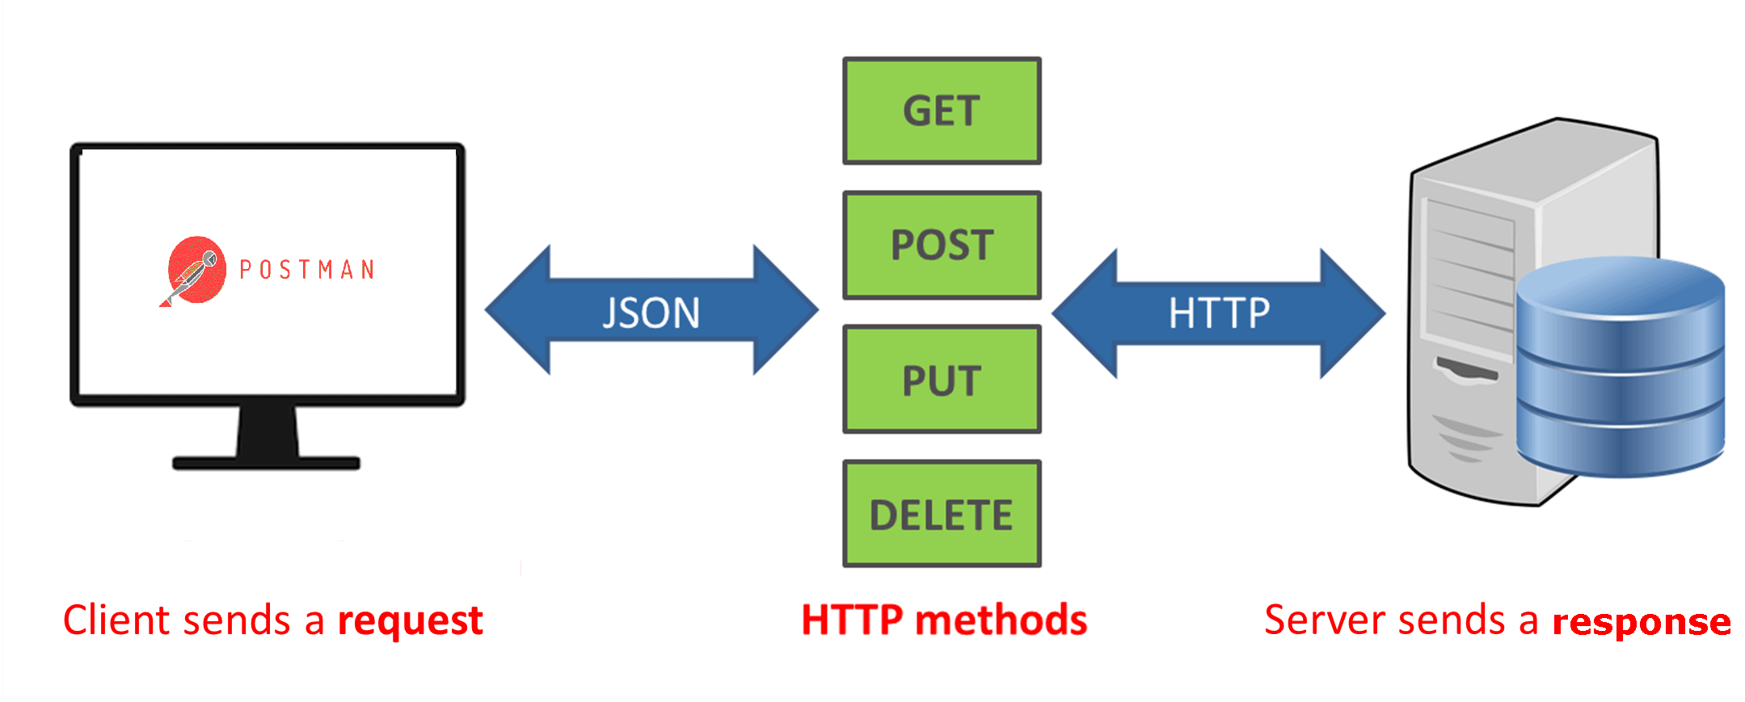
Background
MongoDB
Allows for structured JSON data to be utilized in a way that is efficient for computers to process and natural for humans to read.
Serves as a digital storage room
Node.js
A runtime environment for executing JavaScript code
Powers the development of Web applications
Mongoose
A dependency which will allow the application to connect to my MongoDB database
CRUD Operations
Create (POST), Read (GET), Update (PATCH), and Delete (DELETE)
REST API
A convention for building the CRUD HTTP methods.

Slide 4
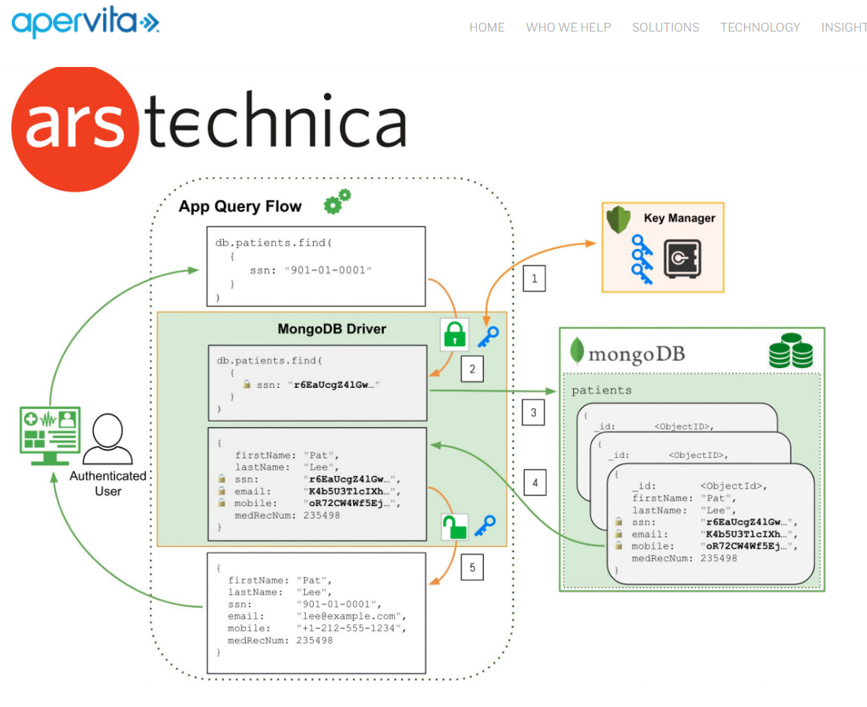
Related Work: Apervita
Located in Chicago, Illinois
Automates a safe communication of records, contracts, and other privacy sensitive documents to a MongoDB server
MongoDB is used for its simple facets that allow structure and retrieval of documents easy to understand

Slide 5
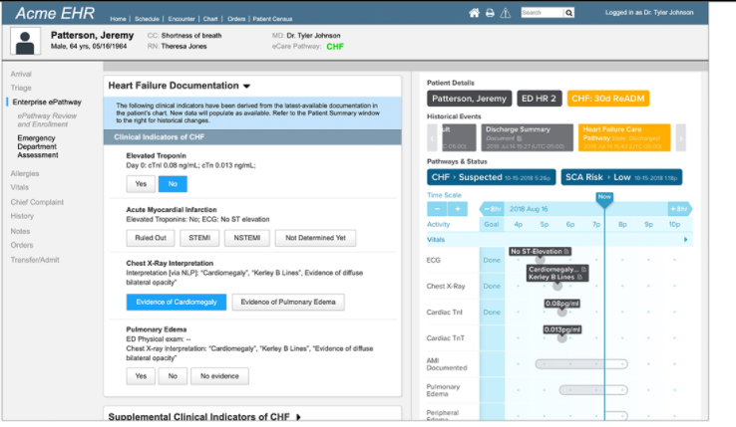
Apervita Website

Slide 6
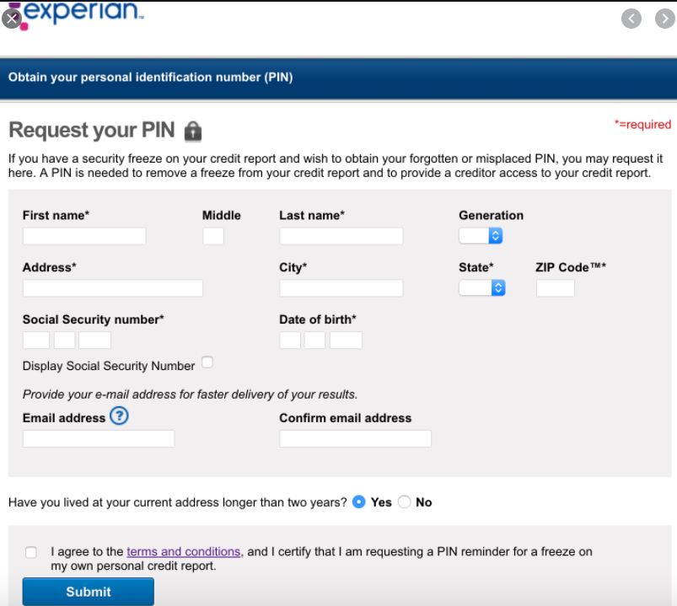
Related Work: Experian Health & Website
Located in Franklin Tennessee
They manage their patient’s identity data using MongoDB.
They use quantifiable predications to select which prescription or treatments that should be used for particular clients.
Their implementation improves the safety, speed, quality, and cost of care for patients and caregivers alike.

Slide 7
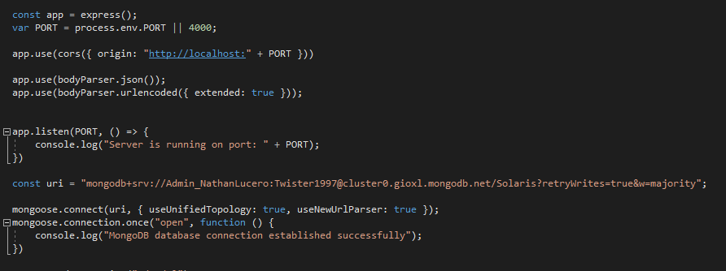
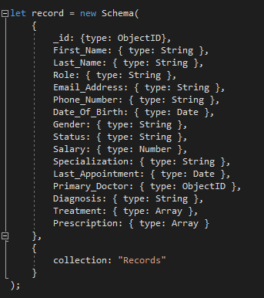
Method 1: Simple REST API
server.js
model.js
Web Server URL or Localhost Port 4000
Mongo User
Password
Collection Name

Slide 8
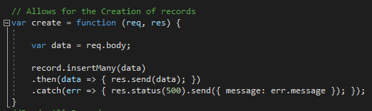
Method 1: Simple REST API
Create Function (server.js)
Create Path (server.js)

Slide 9
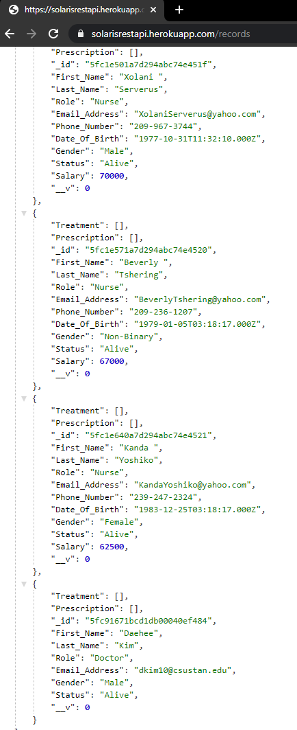
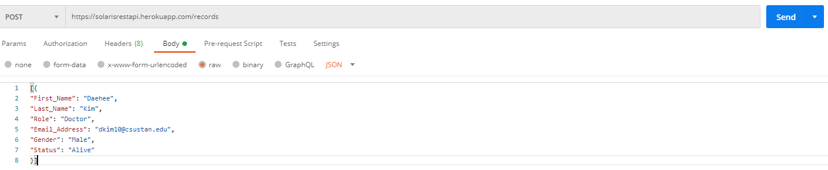
Method 1: Simple REST API Create Demo

Slide 10
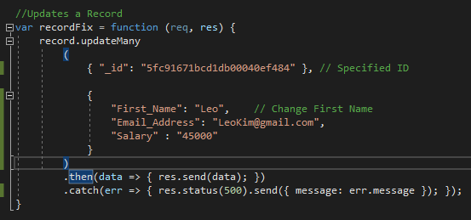

Method 1: Simple REST API
Update Function (server.js)
Update Path (server.js)

Slide 11
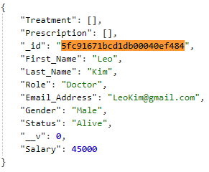
Method 1: Simple REST API Update Demo

Slide 12
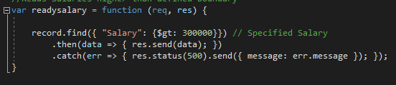
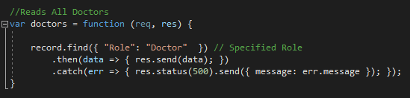
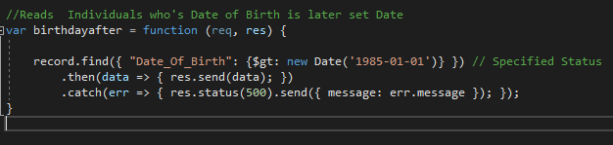


Method 1: Simple REST API
Read Doctors Function (server.js)
Read Dates of Birth Later than 1985-01-01
Function (server.js)
Read Salaries Function (server.js)
Greater Than 300000
Read Salaries Route (server.js)
Read Doctors Route (server.js)
Read Dates of Birth Later than 1985-01-01
Path (server.js)

Slide 13
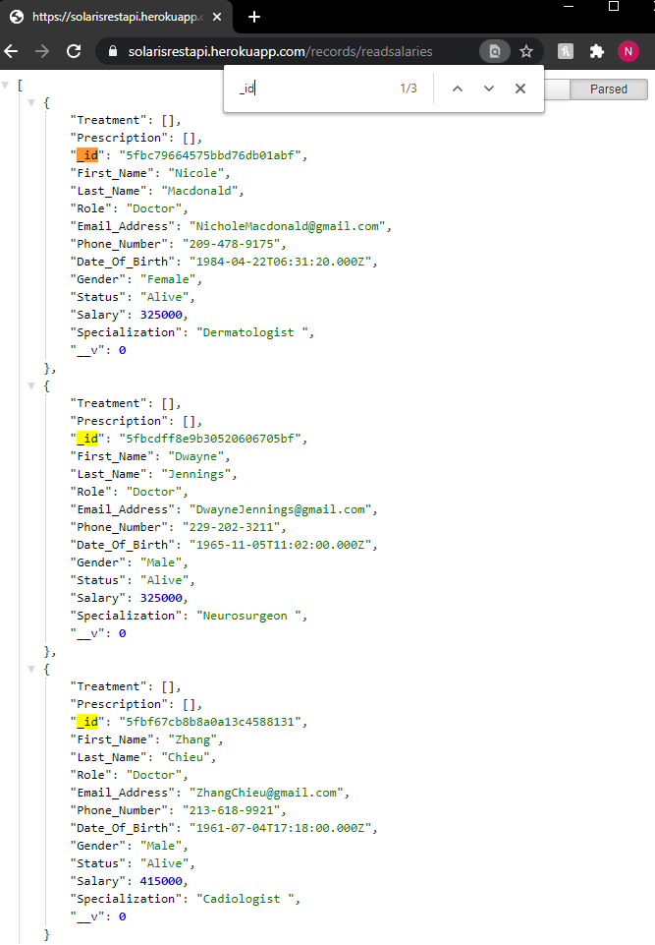
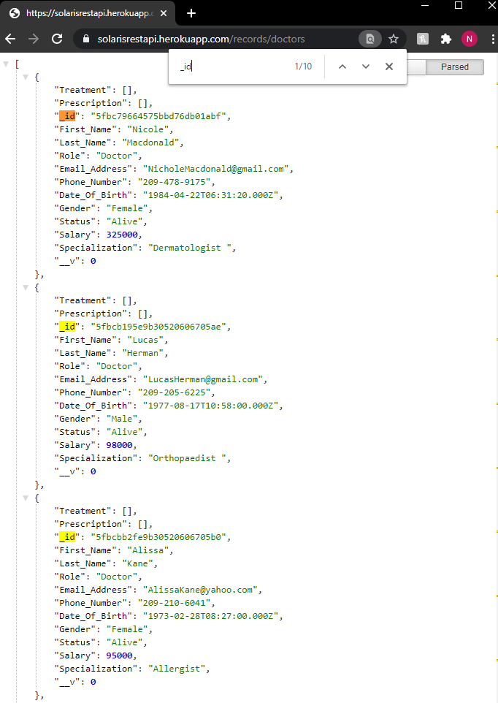
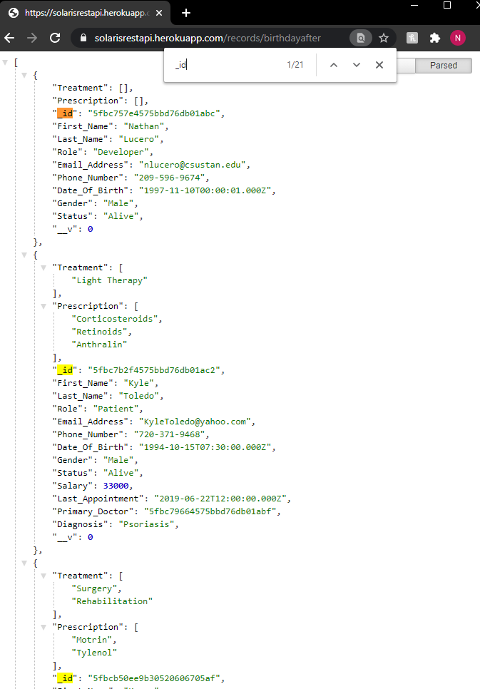
Method 1: Simple REST API Read Demo’s

Slide 14
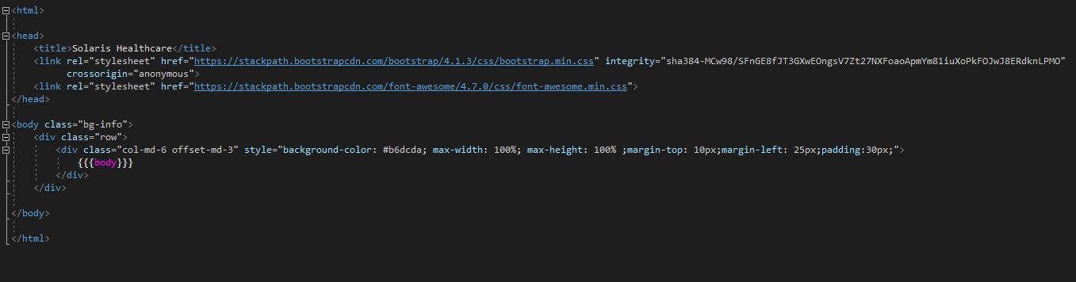
Method 2: Web Application
mainLayout.hbs

Slide 15
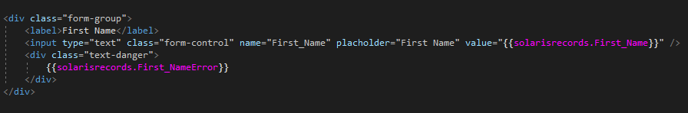

Method 2: Web Application
Label for User to Read
This is the new POST value necessary for the create function
Warning if Field if not Entered
Adds empty text box for user input
Schema Field Entry
Submit Button
Redirects user to link/solarisrecords/list
View All Button
addOrEdit.hbs

Slide 16
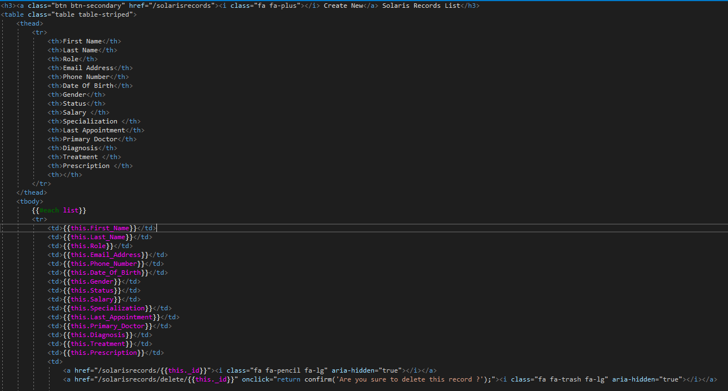
Method 2: Web Application
Redirects user to link/solarisrecords/
Interactive Create New Button
Title
Displays each field horizontally across screen
Used to get the actual data of the specified fields
Interactive Pencil Icon
Interactive Trash Icon
list.hbs

Slide 17
Method 2: Web Application Demo
https://solarisdb.herokuapp.com/solarisrecords

Slide 18
Negative Takeaways
Negatives
Method 1 proposes a complicated CRUD application that depends on a third party application to perform basic HTTP requests
Method 1 also uses a hard code implementation that does not allow a user any flexibility when they want to update, insert, of delete any records at any time convenient
Both Method 1 and Method 2 fail to uphold any security integrity

Slide 19
Positive Takeaways
Using Node.JS to develop JavaScript applications
Familiarized myself with the client-server architecture
I learned what a REST API was
Learned about CRUD operations and their respective HTTP requests
Tracking down where data records are being transferred to
How to use and connect MongoDB to my application
How to deploy apps to a dedicated server where I chose Heroku
How to read server logs when a deployment was failed
Appreciate the work and functionality of the implemented programs

Slide 20
Thank You!
School Email Address: nlucero@csustan.edu
Alternate Email Address: nathanlucero5842@gmail.com

